Slide 1
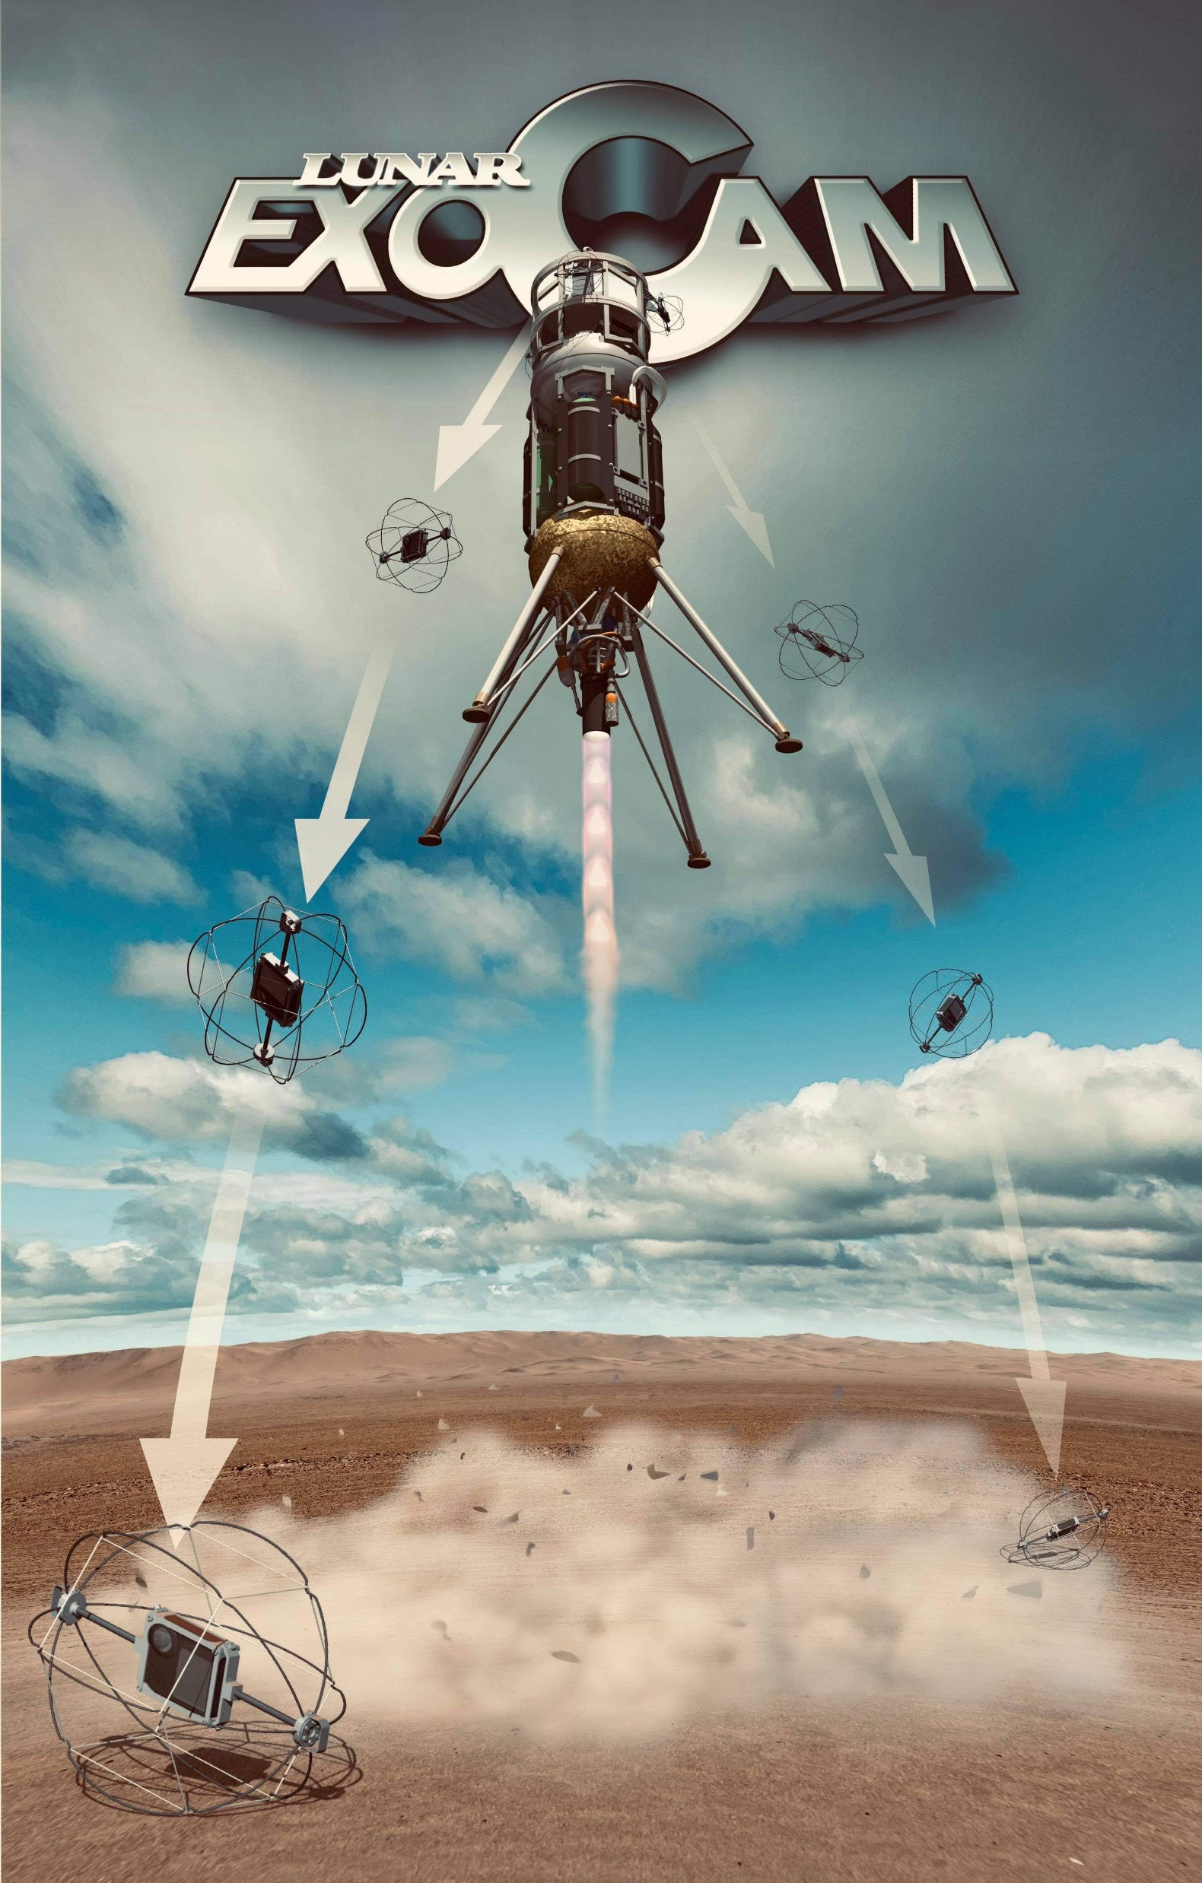





INVESTIGATING
LUNAR PSI
WITH
EXOCAM
LSIC DUST MITIGATION FOCUS GROUP
JASON ACHILLES
Jmezilis@gmail.com
Notes:
Thanks to Melissa Roth @ Off Planet Research and Boon @ Blue Origin @ last week’s LSIC for both independently encouraging me talk to Kristen John (NASA STMD @ JSC) and Jorge Nunez @ Johns Hopkins APL
Led to invitation from Lindsey and Sarah to share this lunar payload concept with you

Slide 2
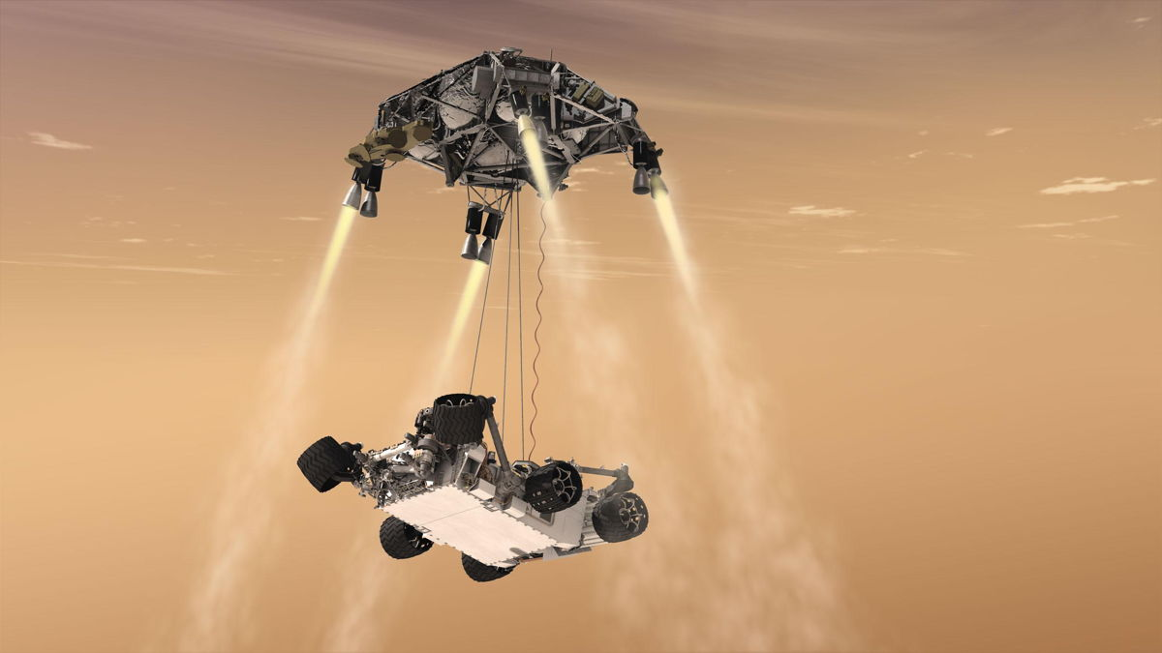
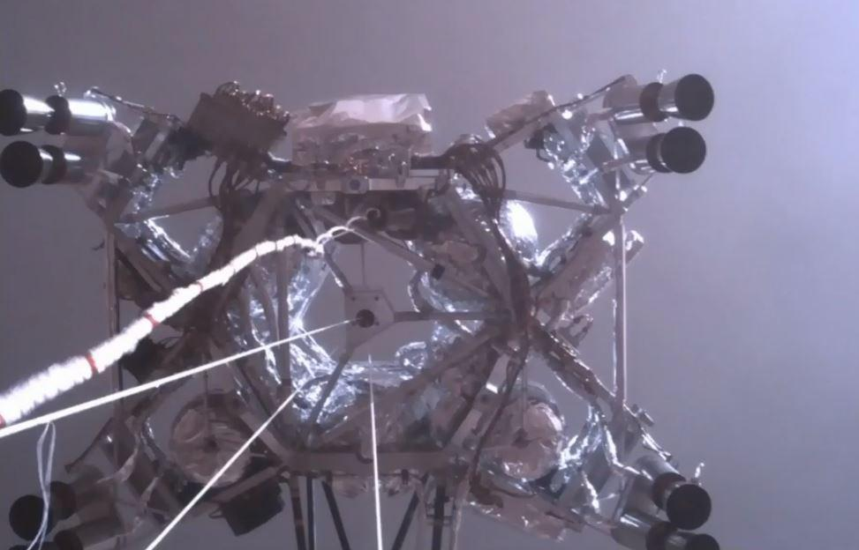
THE VIEW WE WANT
THE VIEW WE’VE GOT

Slide 3
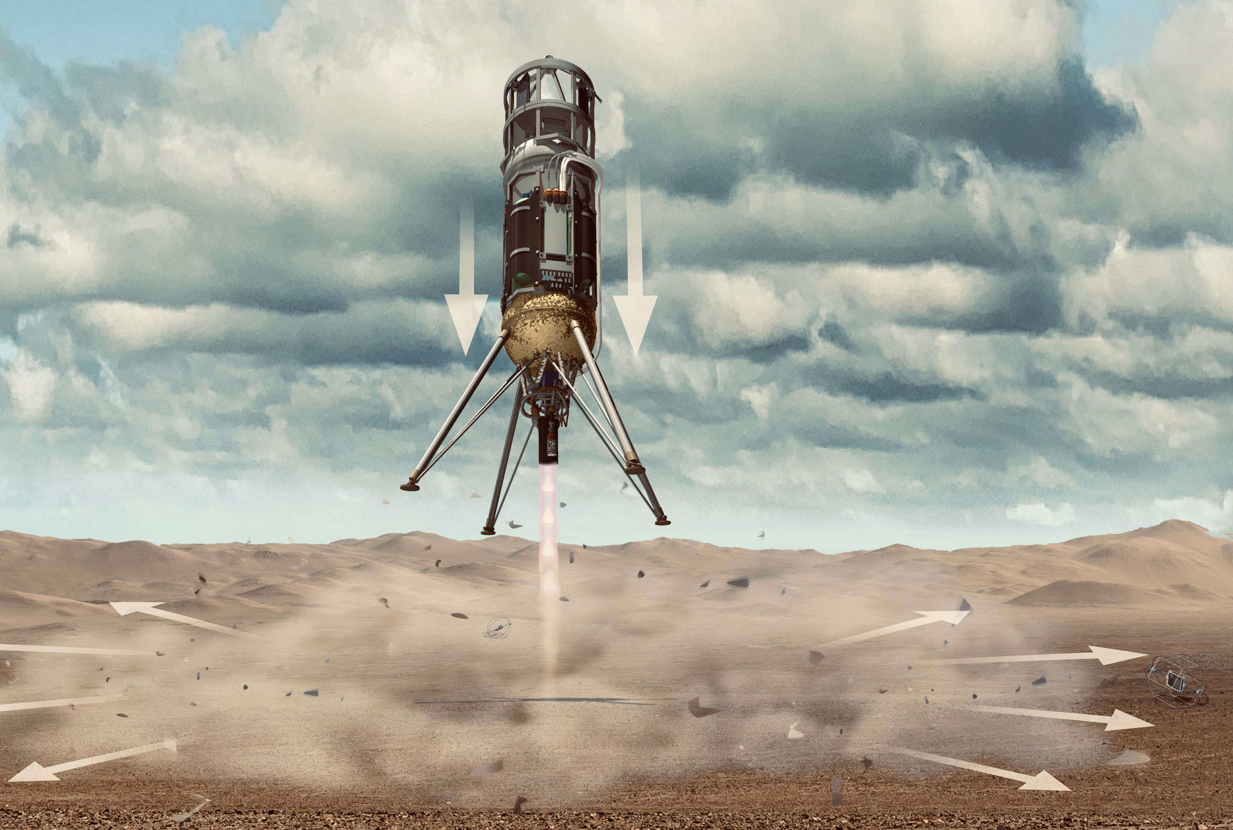
Notes:
Originally encouraged in 2019 by Bill Farrell @ NASA Goddard to pursue PSI modeling as an avenue for NASA funding, based on a unique ability to capture in-situ measurement of regolith plume migration in real time on the lunar surface during the final descent of a rocket / lander on the Lunar surface

Slide 4
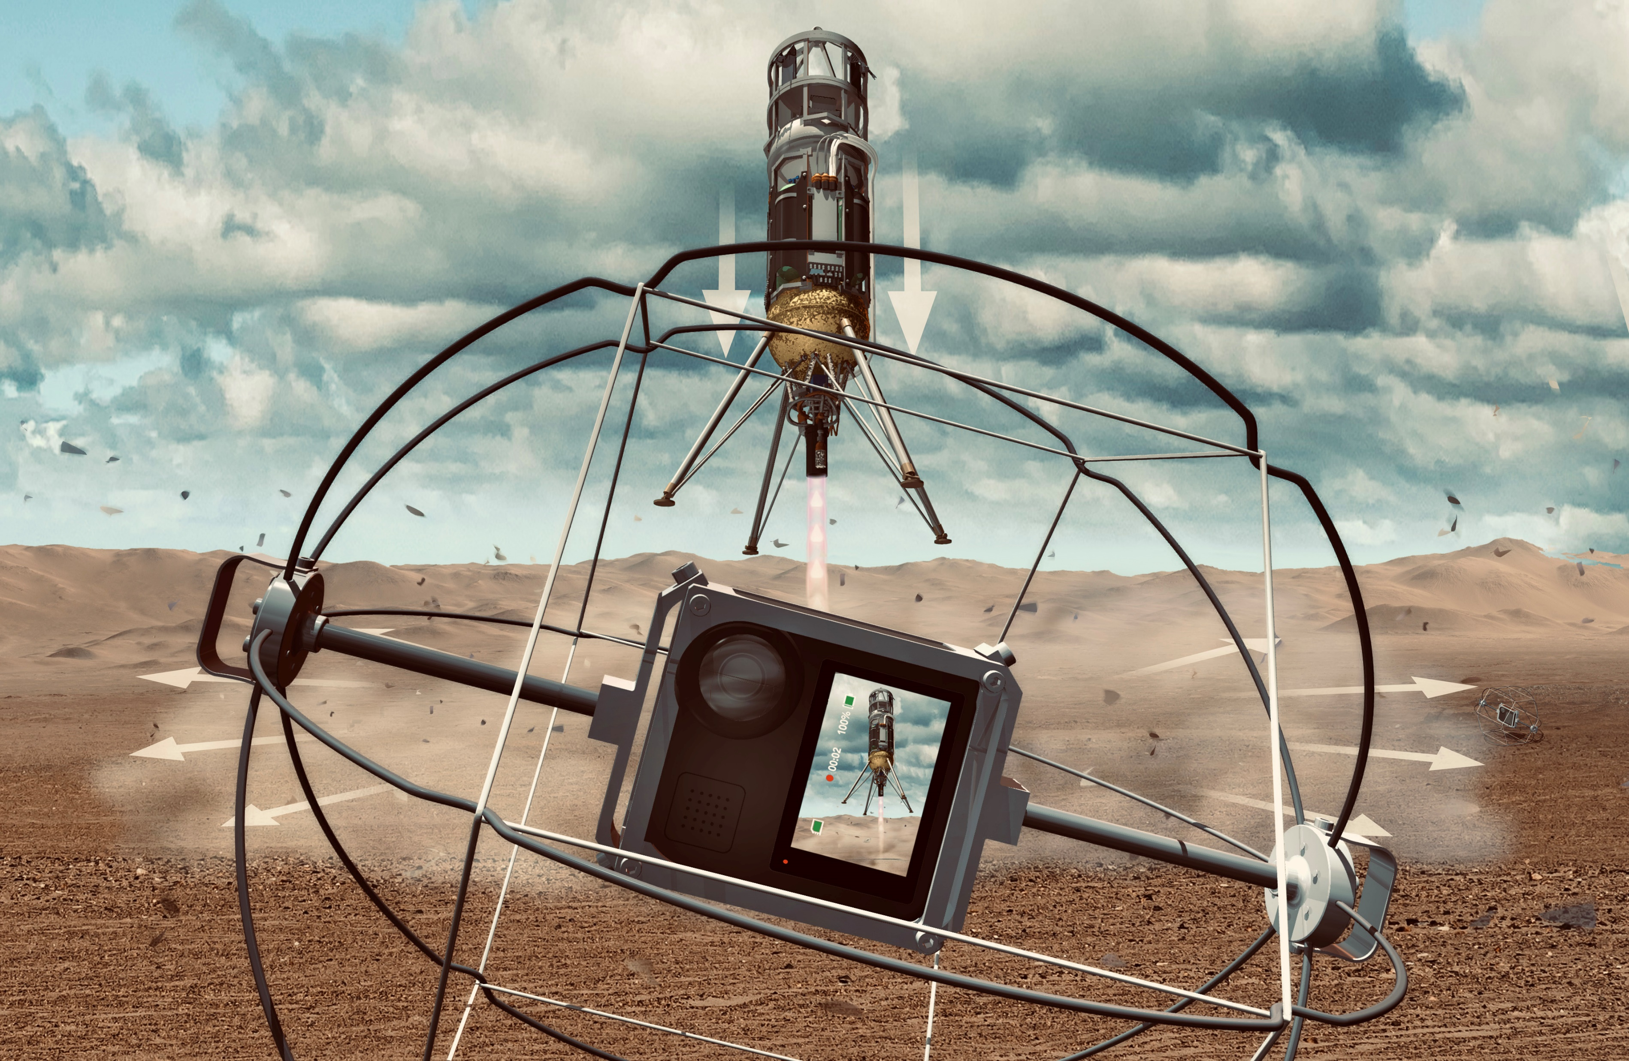
IN SITU, REAL-TIME PARTICLE IMPACT MEASUREMENTS
*We are IN the plume*
Notes:
Originally encouraged in 2019 by Bill Farrell @ NASA Goddard to pursue PSI modeling as an avenue for NASA funding, based on a unique ability to capture in-situ measurement of regolith plume migration in real time on the lunar surface during the final descent of a rocket / lander on the Lunar surface

Slide 5

XODIAC
Suborbital Test Vehicle
LAUNCH DATE
Oct 14th, 2021
Mojave, CA
LAUNCH HEIGHT
25m
15m
LUNAR EXOCAM
PAYLOAD COMPLIMEMENT
360° HD video
Particle Sensor

Slide 6
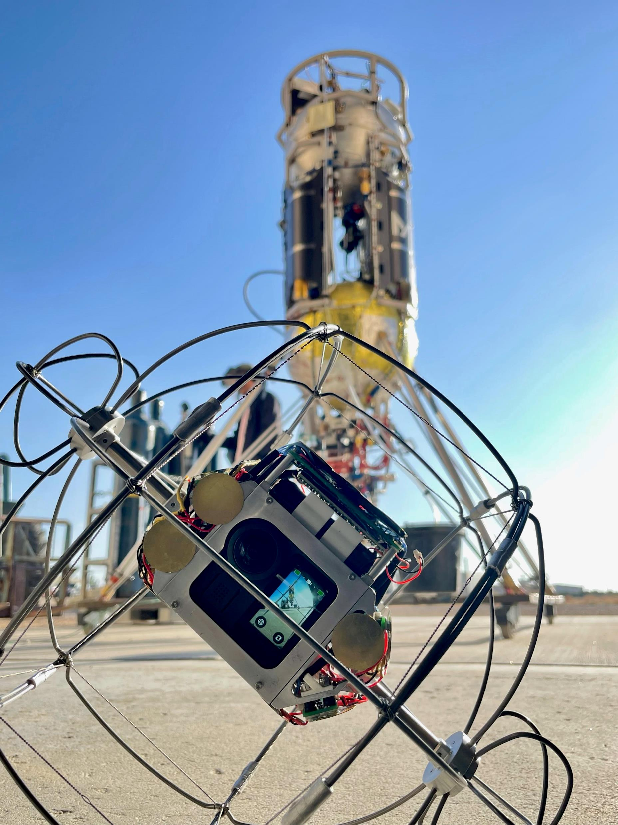
Notes:
NEXT SLIDE _ EXOCAM FLIGHT FOOTAGE

Slide 7
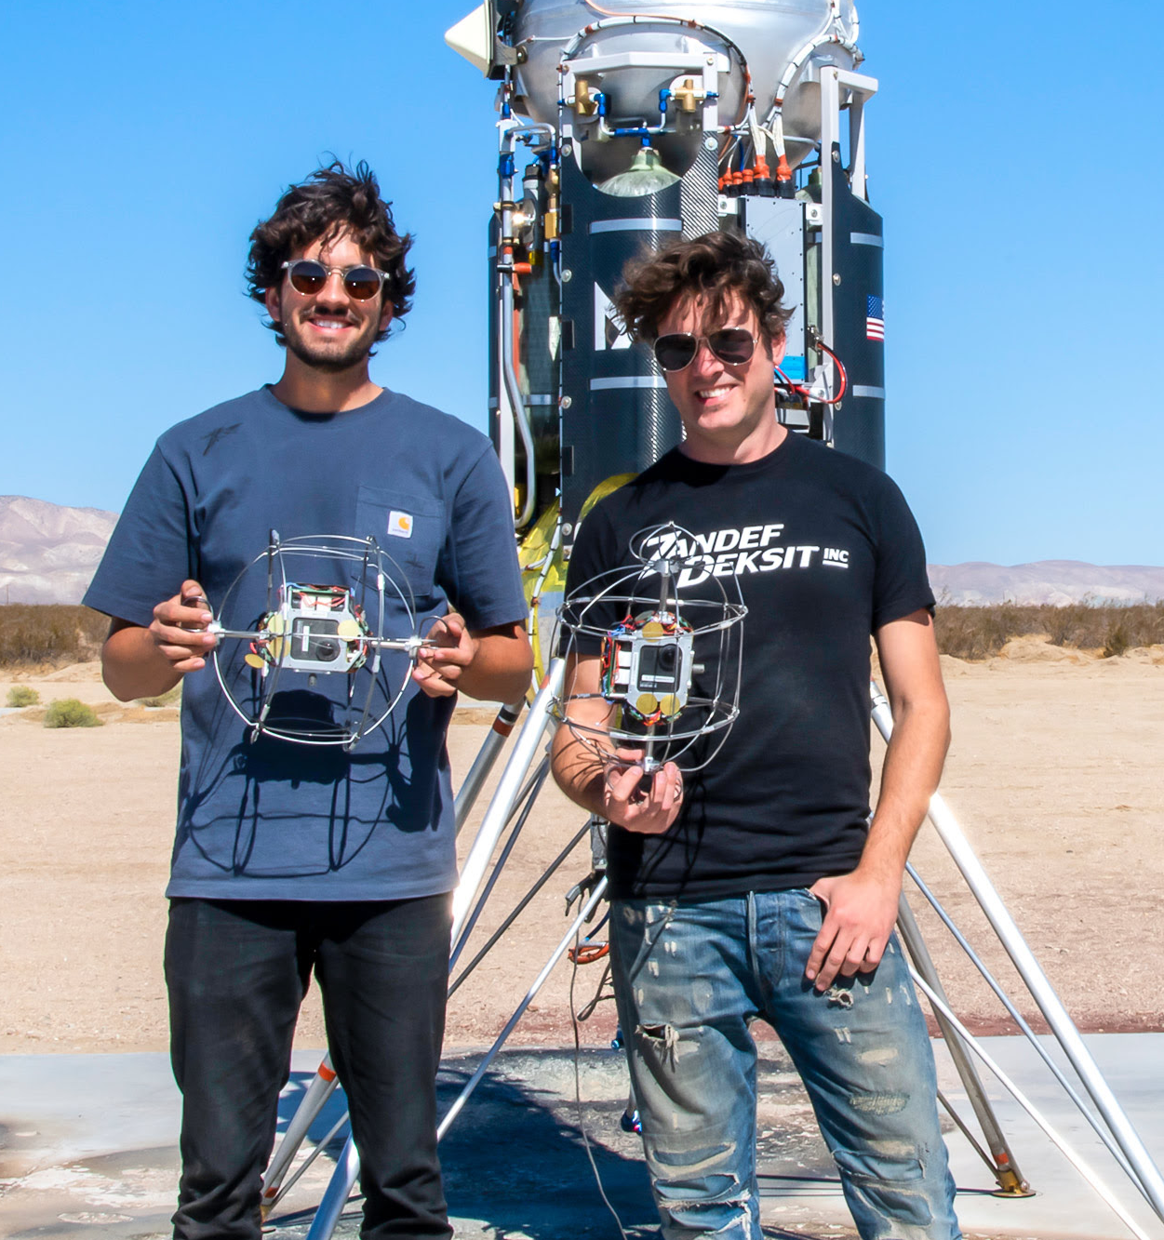
EXOCAM

Slide 8
CAMERA
MODULE

Slide 9
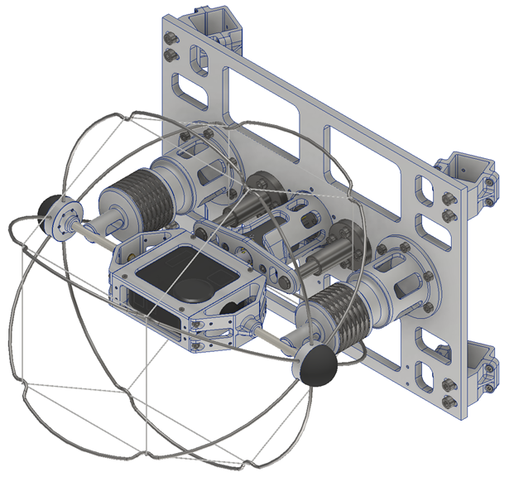
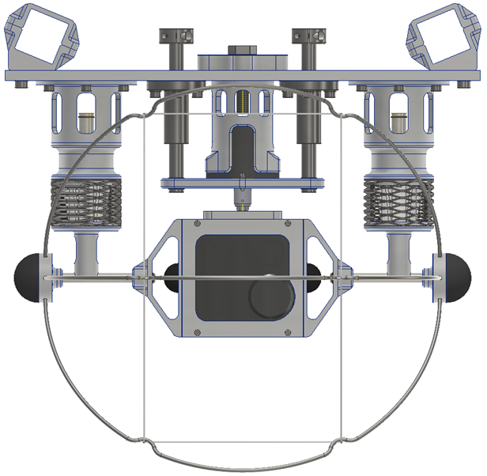
GoPro MAX
360° camera
CAMERA DESIGN
GoPro MAX
360° field of view
30 fps @ 5.4K
WiFi transmission
Robust “horizon lock” auto-leveling software
Battery Operated
“CAGE” SPECS
Successfully flight tested at 50-100g impact / 25m drop
Notes:
Currently working with Redwire / Deep Space Systems for a modified version of their Argus camera line which claimed space heritage in Nov. – Dec. 2022, mounted externally on the solar panels of the Orion Spacecraft

Slide 10
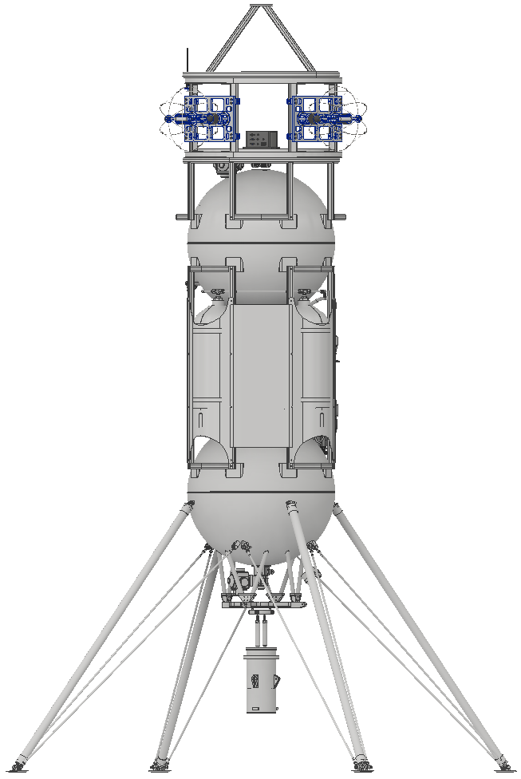
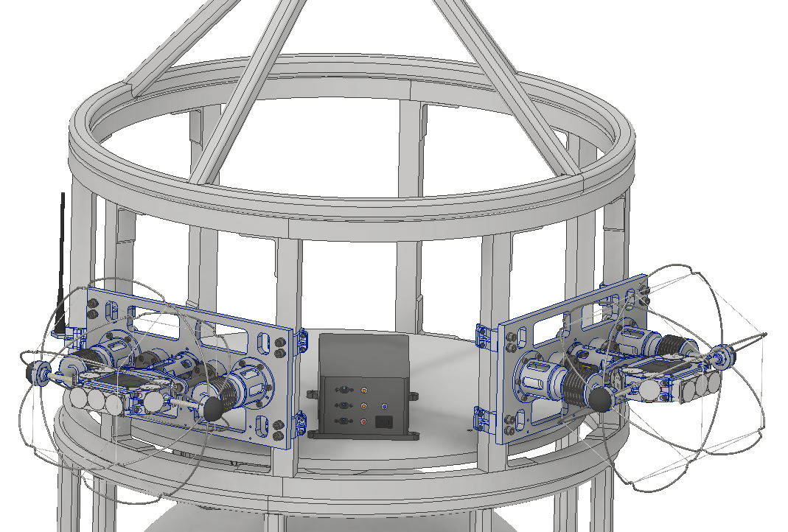
PAYLOAD INTEGRATION
with MASTEN XODIAC

Slide 11
PARTICLE
SENSOR SYSTEM

Slide 12
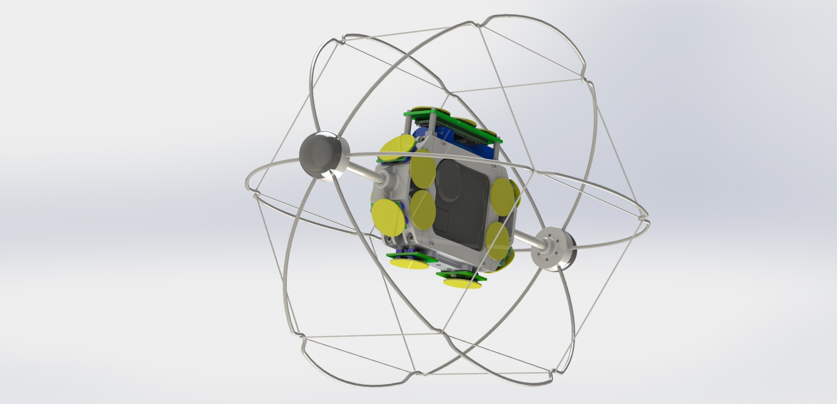
PARTICLE SENSOR SYSTEM
SENSOR INPUT
Piezoelectric Sensors
ORIENTATION
Mounted on all (6) faces
OPERATION
Similar to video camera, sensors will simultaneously capture data from all angles
All sensors record data on separate channels
Highest possible sample rate for clarity of impact data
Particle filtering for multiple sensors across each 3D axis

Slide 13
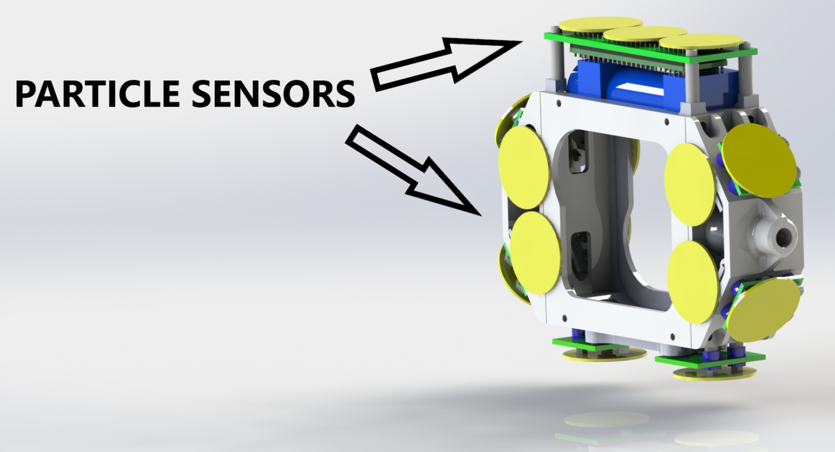

Slide 14
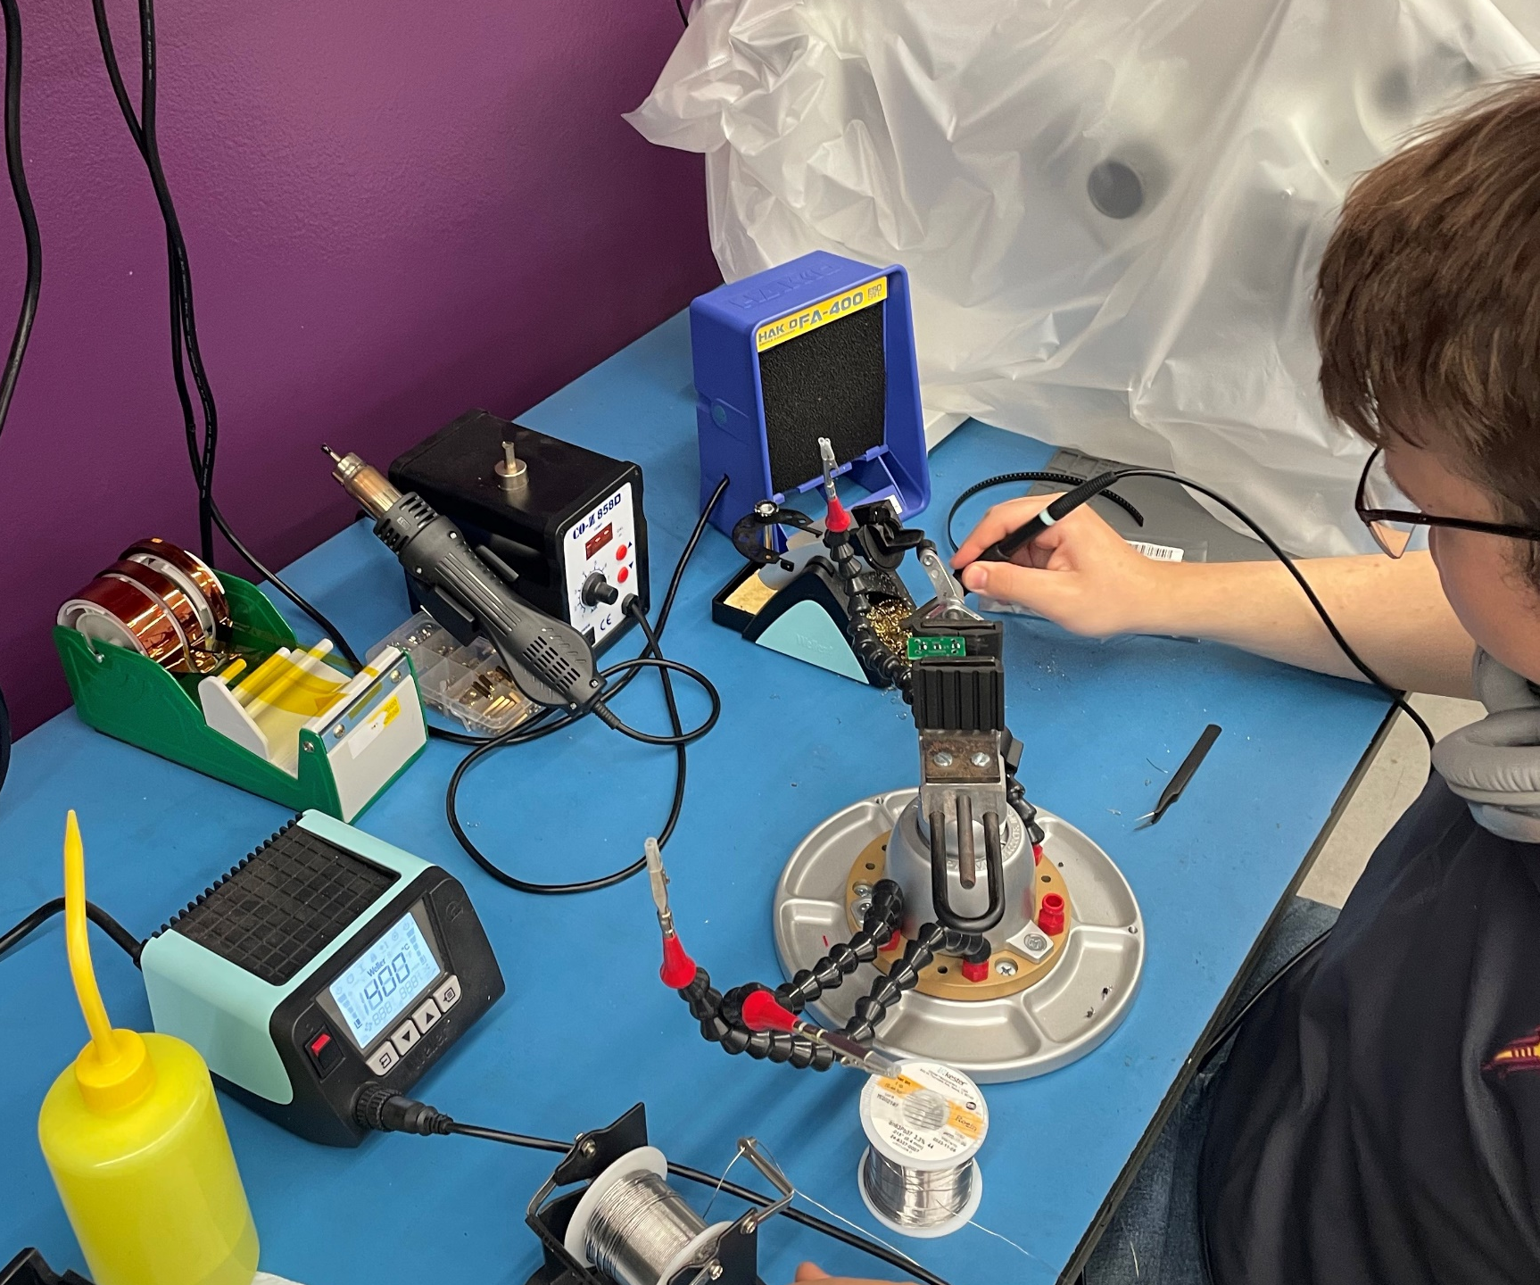
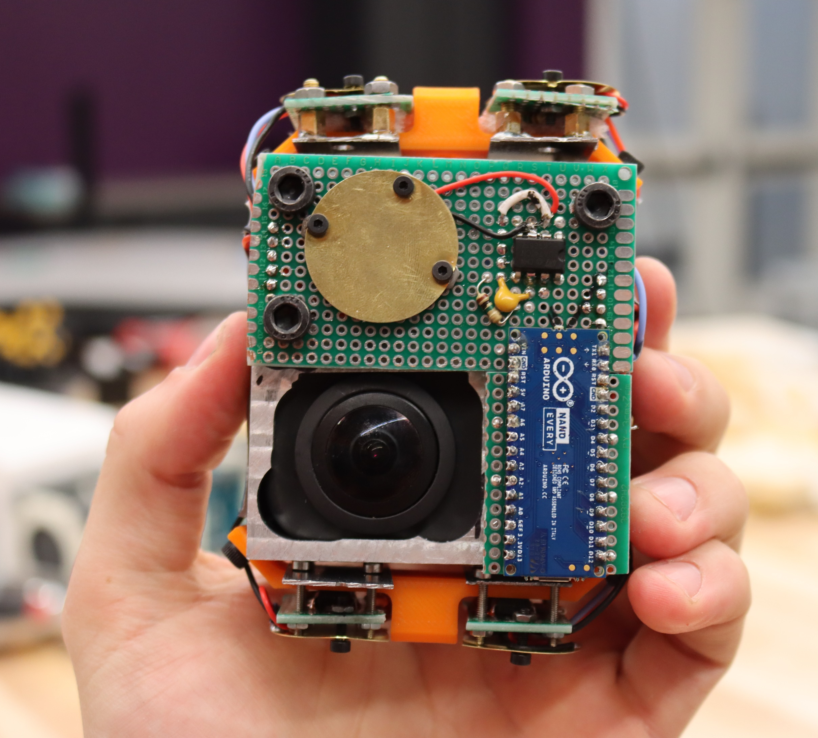


Slide 15
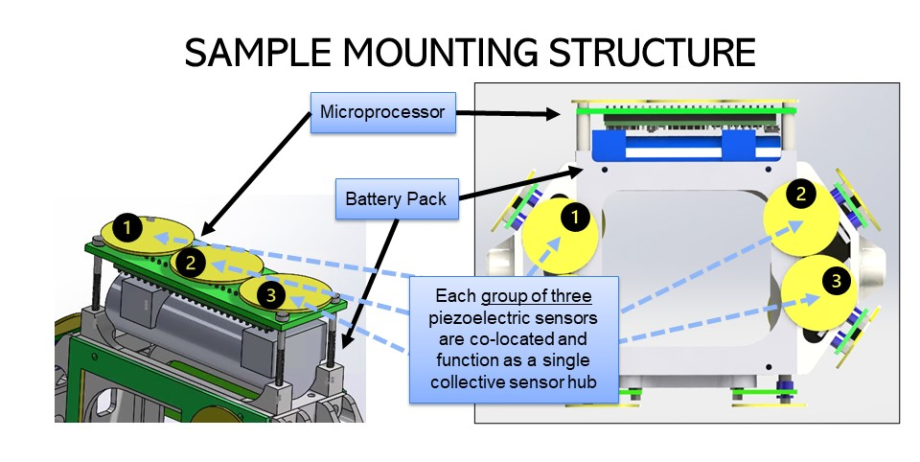

Slide 16
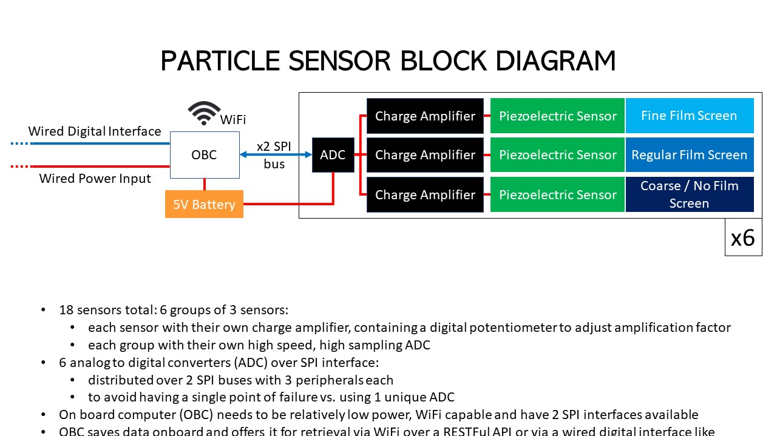

Slide 17
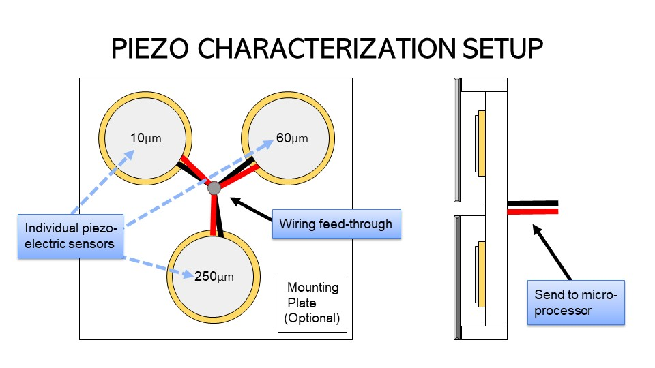

Slide 18
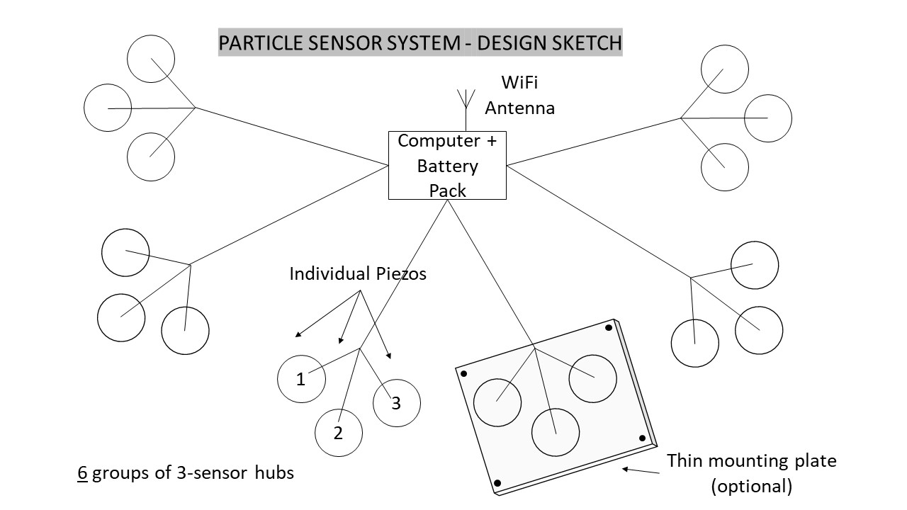

Slide 19
ADDITIONAL PSI DATA
360° CAMERA
“Look” everywhere, all at once
“Look” specifically at emplaced light beacons on lander to provide real-time regolith plume density measurement
  single broadband (full spectrum) light source
  separate (varied wavelength) narrow band sources
COUPONS
Directly measure dust accumulation throughout plume interaction (via camera)

Slide 20
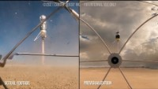

Slide 21
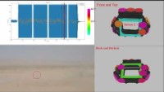

Slide 22
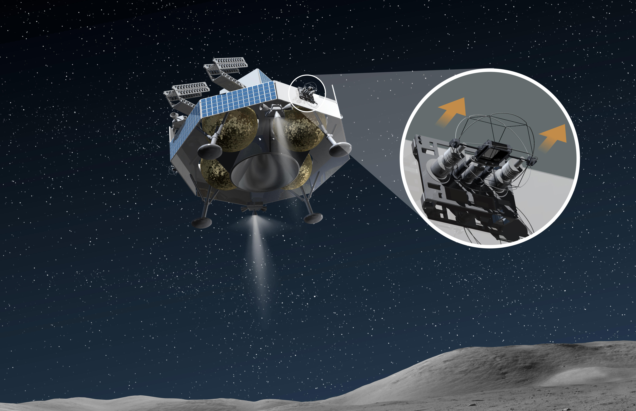
Notes:
NEXT SLIDE - SOCCER

Slide 23
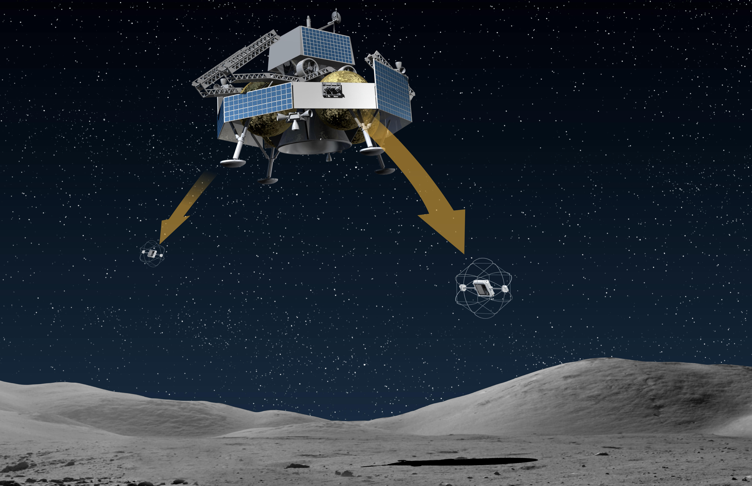
Notes:
NEXT SLIDE - SOCCER

Slide 24
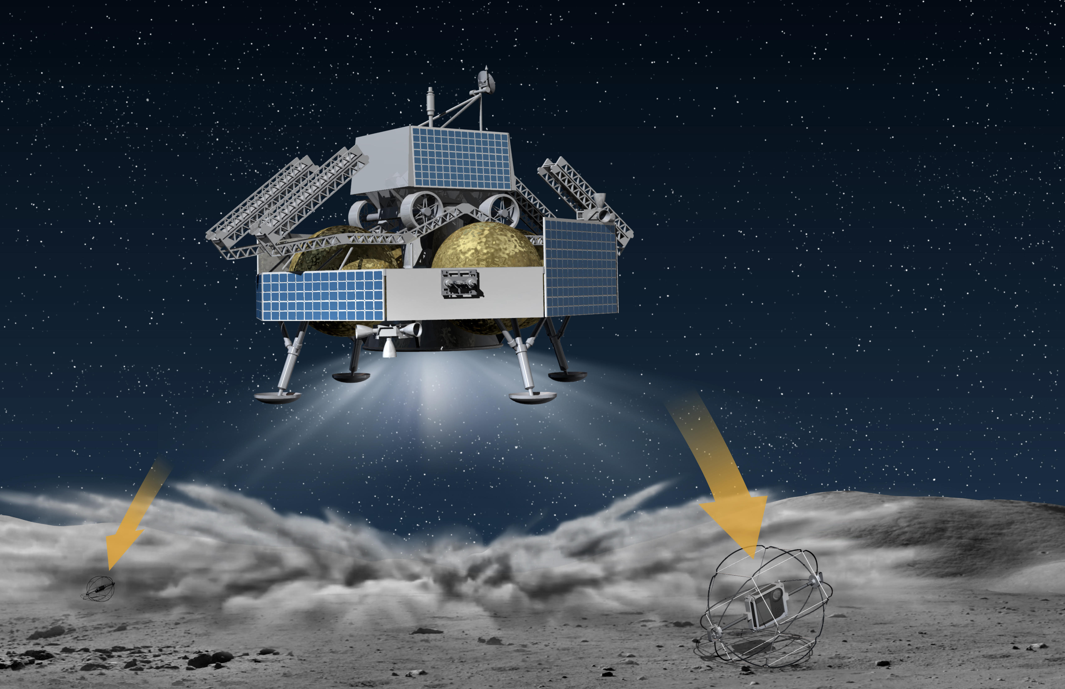
Notes:
NEXT SLIDE - SOCCER

Slide 25
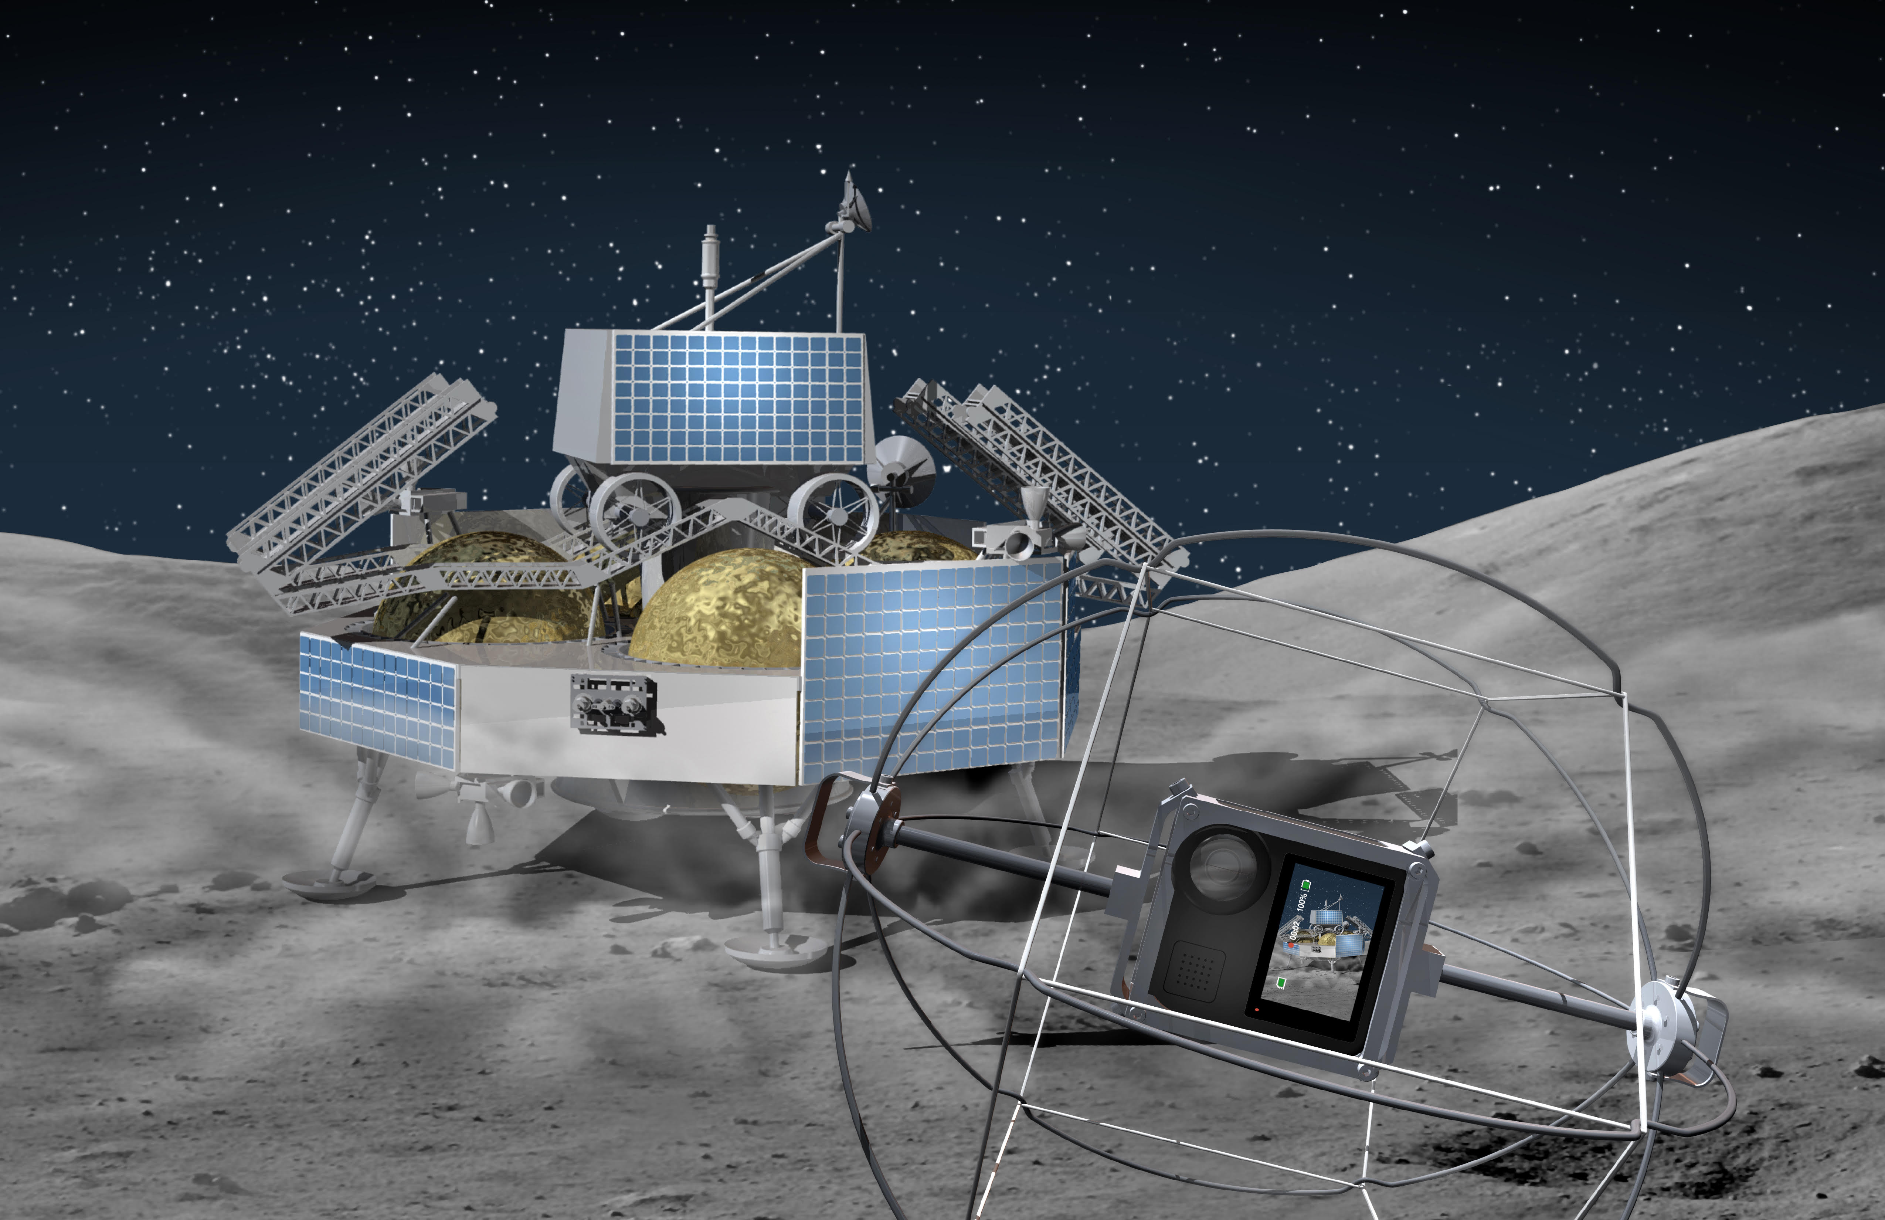

Slide 26

LUNAR EXOCAM
JASON ACHILLES
Jmezilis@gmail.com

Slide 27

IS
EVERY
THING
INSPIRATION

